Slide 1
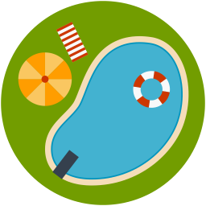
Swimming & Staying Cozy :)
Noor Aftab
Notes:
Pool icon from: http://www.myiconfinder.com/icon/pool-swim-swimming-waves-water-olympics/22390
So, my project is about swimming pools and when it's best to swim in them! More details to come

Slide 2
Agenda!
1. Q
2. M
3. R + I
4. Iteration Q
5. Iteration M
6. Iteration R + I
Notes:
I'll just put this here so the people taking notes know what to expect - it's basically my QMRI for my main model and then the QMRI for my iteration
Acronyms:
• Q - Question
* M - Model
* R - Results
• I - Interpretation

Slide 3
Question
In the past year, what were the most comfortable days to go swimming in the average pool in South Hadley?
Comfortable defined as water temperature ≥ 26°C/78.8°F
Year defined as 1st December 2018 - 1st December 2019
Average defined as 22.6mx12.8m
Notes:
To state it formally, my question was if you consider a pool in South Hadley (where Mount Holyoke is), with the average dimensions of public pools in our area. what were the best days from the past year to go swimming? (Best as in you don't wanna screech when you touch the water)
Also,the pool does also have a depth of 1.5m, which I didn't mention here because I was really sleep deprived when I made this

Slide 4
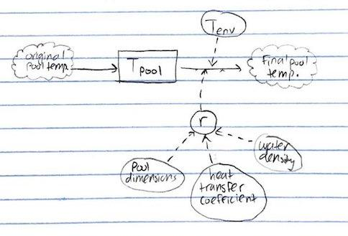


Model
h - heat transfer coefficient
A - pool surface area
C - heat capacity
m - pool mass, c_{p} - specific heat of water
Mathematical
Stock & Flow
(and then I just did that for a year's worth of daily max. air temperature data)
Notes:
The model was pretty much based off the Newton's Law of Cooling, except I did a bit more research into the value of r and how it changes with temperature.
I ran it on data for daily maximum air temperatures in the past year and I use maximum specifically because I just figure it affects people more than the average. Like, you're probably gonna go swim when it's warmest out - whether this was good data to use is still kind of up for debate

Slide 5
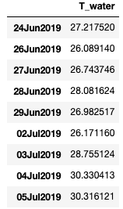
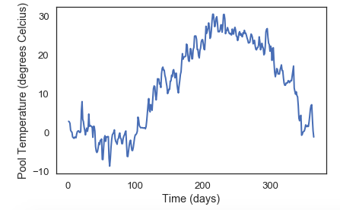
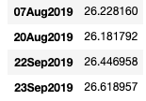
Results + Interpretation
.
.
.
32 Total Days!
Notes:
So I got a plot of the pool's temperature over the year - the big peak there is summer!
And since a comfortable temperature is anything 26C and above, I just parsed through those values and pulled out all the relevant dates, which is what you see on the right
I noticed there were 32 total good days, which led me to my iteration questions

Slide 6
Iteration Question!
How does pool surface area affect the number of comfortable days to swim?
Notes:
How does the surface area of a pool affect how many days it's is comfy to swim in (still using our data from the past year)

Slide 7
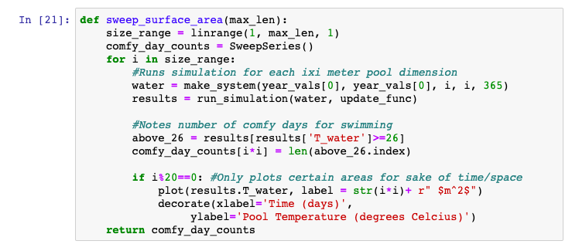
Model Iteration
Basically sweeps through different surface areas and plots them
Notes:
I didn't do anything super fancy - I just swept through the lengths and widths and stored the number of nice swimming days from the results - to decrease run time, I made all the pools square so you only need one length value to get an area.

Slide 8

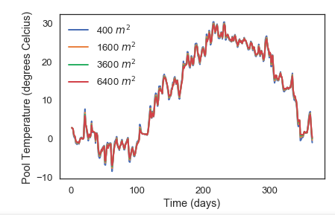
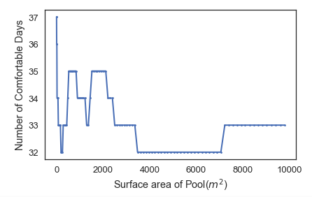
Iteration Results + Interpretation
+Assumptions/Failings
Notes:
(Ran it for 1by1meter pool up too a 100by100 meter pool)
So it's a little hard to see on the graph on the left, but if you squint you can kind of see how the pool with bigger surfaces gain heat slower and lose heat at a slower rate, which felt intuitively correct to me (although the low temperature change doesn't)
The plot on the right is the count of good days to swim vs the pool's surface area, and there's admittedly a lot of variation - not great - but you can see a general downward trend so I'd say the answer to the question is pools with smaller surface are comfier to swim in more days out of the year.
Worth noting that there were a lot of things I didn't really take into account, which I probably should've - sunlight, wind speed, the ground being heated up, stuff like that.

Slide 9

Notes:
Slide credits! Thank you for listening :)

